Slide 1
Measures of Central Tendency
Prepared By
Sajana Shakya

Slide 2
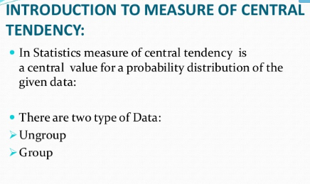

Slide 3
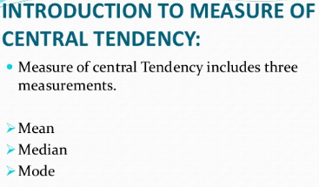

Slide 4
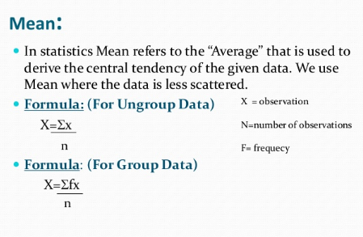

Slide 5
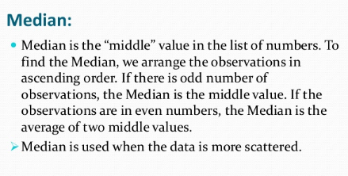

Slide 6
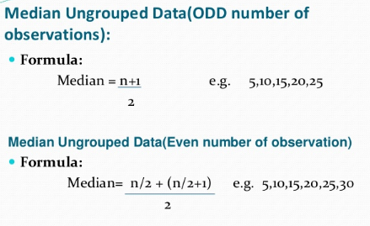

Slide 7
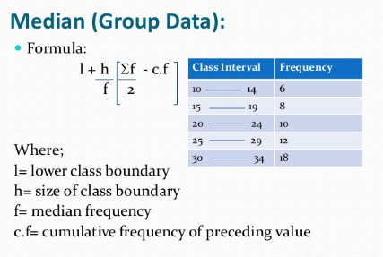

Slide 8
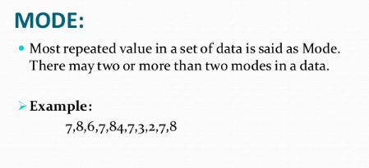

Slide 9
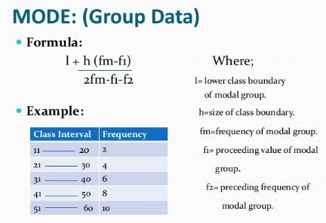

Slide 10



Slide 11

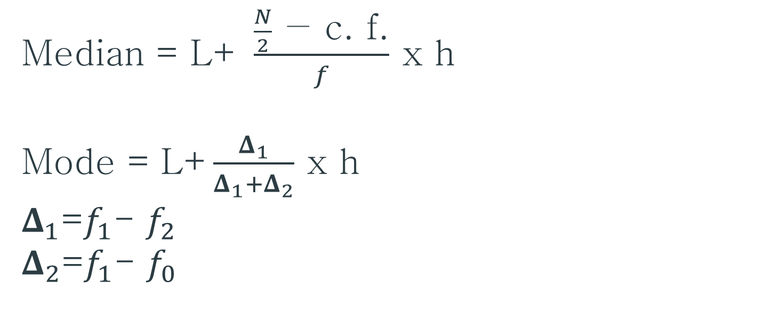
Median = L+ $\frac{\frac{N}{2}\text{ − }\text{c}\text{. }\text{f}\text{.}}{f}$ x h
Mode = L+$\frac{Δ_{1}}{Δ_{1}+Δ_{2}}$ x h
$Δ_{1}$=$f_{1}$- $f_{2}$
$Δ_{2}$=$f_{1}$- $f_{0}$

